Slide 1
‘Preparation of communication material’ relating to Nep- 2020 Adult Education
c. Lalhrilliana
Teacher
Govt middle school
Champhai mizoram

Slide 2
ADULT EDUCATION
Adult Education is a practice in which adult engage in a systematic and sustained self educating activities in order to gain new forms of knowledge, skills, attitudes or values. It is also called continuing education, any form of learning undertaken by or provided for mature men and women.

Slide 3
Types:
Education for vocational, technical and professional competence.
Education for Health, welfare and family living.
Education for civic, political and community competence.
Education for ‘self fulfilment’.
Remedial education, fundamental and literacy education.

Slide 4
Aims:
Adult Education aims at extending education options to those adults, who have lost the opportunity and have crossed the age of formal education; but now feel a need for learning any type, including literacy basic education, skill development, vocational education and equivalency.

Slide 5
Importance:
Adult education is essential developing new skills or retaining
Adult learners are physically and mentally healthier
Learning later in life makes you more open-minded
Learning reduces the prospensity to re-offend

Slide 6
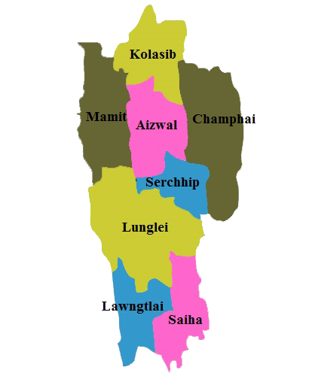
Adult Education Programme was started from 1971 in Mizoram under The Directorate of School Education . It was set up in separate wing named Adult Education wing used to have various Schemes and projects. Due to have financial constraints, literacy drive could be undertaken in three district only. District Adult Education who in turn are supported by circle Adult Education Officers
AREA COVERED
DISTRICT
Aizawl East District
Aizawl West District
Lunglei District
Eastern Part of Aizawl District, Serchip and Champhai District
Western Part of Aizawl District Kolasib and Mamit District
Lunglei, Lawngtlai and Siaha District.

Slide 7
In Mizoram, The Programme will be implemented through Voluntary agencies, Particularly the young Mizo Association, Kristian Thalai Pawl, Thalai Kristian Pawl, etc. In areas effective Voluntary agencies do not exist. The Programme will be implemented through departmental agencies. The Programme also envisages launching of one non-formal education project every year as Centrally Sponsored schemes. Training of supervisors and instructors will be conducted in collaboration with the Mizoram Institute of Education and the Voluntary organizations concerned. Adult Education board/ Committee will be constituted at the state, District, Block and village level with adequate representation from the Voluntary agencies involved in the Programme. Adult Education wing also publish a monthly Magazine named ‘ MEICHHER’ which is distributed free of cost.

Slide 8
In the new National Education Policy 2020, suggested by Ministry of human Resource Development, Government of India. The Curriculum framework of Adult Education will include five types of Programmes:
Foundational Literacy and numeracy.
Critical life Skills, Including financial literacy, digital literacy, commercial skills, health care and awareness, child care and education and family welfare.
Vocational Skills development with a view towards obtaining local employment.
Basic Education including courses in arts, sciences, technology, culture, sports and recreation as well as other topics of interest or use to local learners, such as more advanced material on critical life skills

Slide 9
Suggestions for Promoting Adult Education in Mizoram.
The Govt should recruit voluntary teachers who will give after school classes to adult learners free of cost.
As in practice, volunteers from Yma, Ktp and Ngo’s should be paid to give vocational guidance to adult learners
Names of illiterate adults must be collected during census and should be provided learning as discuss above.
Various depts. Under the govt should help the adult by giving them career guidance an counselling within the office hours free of cost, and within the assigned period of time.
The retired teachers schoukd be re-employed by the govt to give free teaching to illiterate adults. The 3 Rs must be the focus in this learning session.
All churches should participate in promoting adult literacy and employment. Apart from church services, they should take extra measures to promote adult education.

